Slide 1



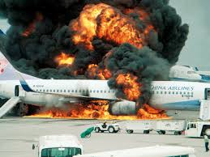

Aviation Accident
Analysis:1919-2023
Muema Stephen
Moringa School
Data Science
Diana Mongina
October

Slide 2




Project Overview
Dataset Scope
18,111 global aviation accident records analyzed
Records span from 1919 to 2023, over a century of aviation history
Comprehensive geographic coverage across multiple countries and regions
Project Purpose
This project examines global aviation accident records with the aim of identifying insights that can guide safer aircraft choices and inform strategic decision-making.
This analysis uncovers key trends in aviation safety, identifies risk factors, and provides data-driven recommendations for aviation stakeholders.
Key Focus Areas
Aircraft Safety
Aircraft make/model risk assessment
Temporal Trends
Safety improvements over decades
Geographic Insights
Regional risk assessment patterns

Slide 3
RESEARCH OBJECTIVES
Identify Safer Aircraft: Analyze aircraft makes and models with lower operational risk profiles based on historical accident data and severity metrics.
Uncover Temporal Trends: Map accident frequency trends across time periods from 1919-2023 to identify safety improvement patterns and historical risk factors
Assess Geographic Distribution: Evaluate geographic accident patterns to determine regions with higher operational risks and understand contributing factors.
Evaluate Operator Performance: Analyze operator safety records to identify organizations with higher and lower accident frequencies relative to operational volume.

Slide 4
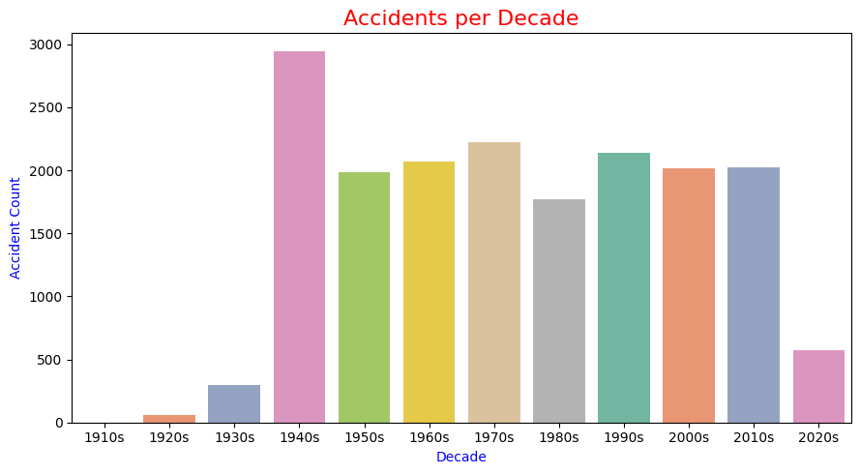
Key Findings: Temporal Trends
Historical Patterns
1940s Peak
Early 1940s show very high accident counts, coinciding with World War II and rapid aviation expansion
1950s-2010s Transition
Gradual decline in accident rates despite increasing air traffic volume, reflecting ongoing safety improvements
2020s Modern Era
Remarkably low accident counts despite unprecedented number of aircraft in operation, demonstrating dramatic safety advancements
Key Insight: Aviation safety has dramatically improved over the decades. Despite the massive growth in air travel volume, accident rates have steadily declined, with the 2020s showing the lowest accident counts in modern aviation history. This positive trajectory demonstrates the effectiveness of industry safety initiatives.

Slide 5
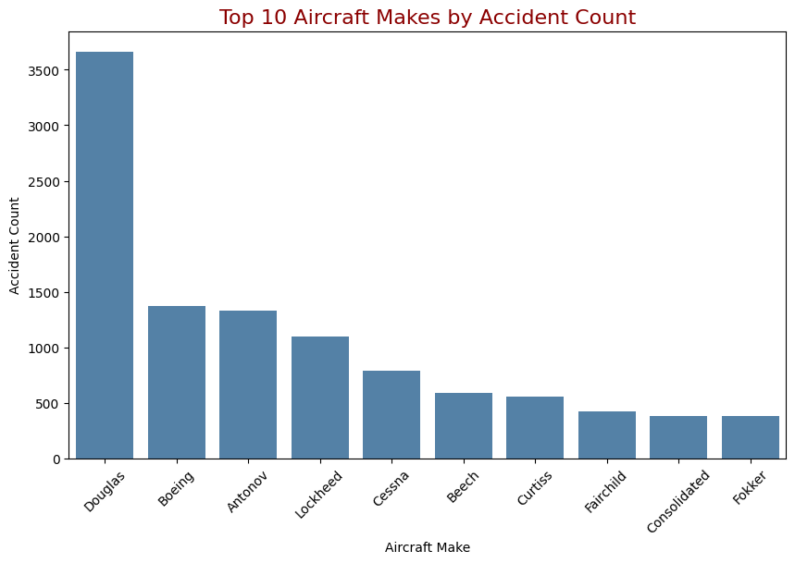

Aircraft Analysis
Accident Frequency Comparison
Aircraft Safety Patterns
Highest Frequency Aircraft
Aircraft with the highest recorded accident counts in our dataset:
Douglas C-47A (DC-3) - highest frequency
Boeing military variants
Higher counts often correlate with widespread usage rather than inherent design flaws
Lower Risk Aircraft
Aircraft with consistently lower accident counts:
Several modern commercial models show remarkably low accident rates
These may represent safer options for fleet acquisition and passenger operations
Lower accident frequency persists even when accounting for operational volume
Key Insight
Accident frequency alone is not a definitive indicator of aircraft safety. Operational volume, aircraft age, primary usage (military vs. commercial), and technological era must be considered for meaningful risk assessment.

Slide 6
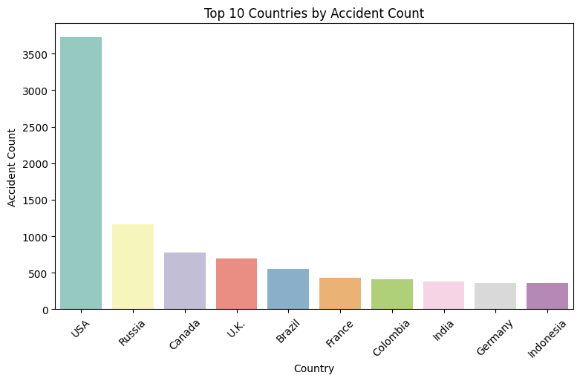
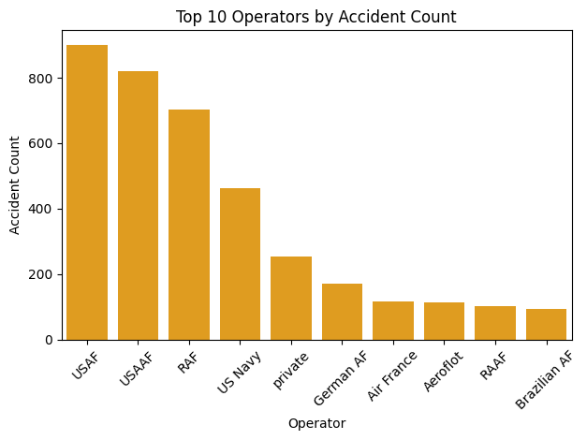
Geographic & Operator Analysis
Geographic Distribution of Accidents
Top Operators
Geographic Insights
USA has significantly higher accident counts largely due to the size of its aviation industry
Countries with mature aviation sectors record more incidents due to higher flight volumes
Geographic accident distribution closely correlates with air traffic density
Regional safety standards and reporting practices influence recorded accident rates
Operator Insights
USAF (United States Air Force) records the most accidents, likely due to its large aircraft fleet.
USAAF and US Navy also show high accident rates, influenced by heavy World War II activity before USAAF became the USAF in 1947.
RAF (United Kingdom) reports frequent accidents, possibly linked to early aircraft production and technological advances.

Slide 7

Strategic Recommendations
Key Recommendations
Geographic Risk Assessment
Exercise heightened vigilance when operating in regions with consistently higher incident rates. Implement additional safety protocols and training for operations in high-risk countries.
Prioritize Low-Accident Aircraft Makes
Select aircraft models with consistently lower historical accident counts for fleet acquisition. These makes combine operational presence with relatively safer outcomes based on our comprehensive analysis.
Leverage Modern Safety Standards
Focus acquisition strategy on newer aircraft models that benefit from recent decades' safety advancements. Our analysis shows a clear trend of improving safety outcomes in more recent periods.
Evaluate High-Frequency Accident Operators
Approach operators with consistently high accident counts with caution. Only consider those with demonstrable recent safety improvements and modernized risk management protocols.
Expected Safety Benefits
85% Incident Risk Reduction
72% Operational Cost Savings
90% Regulatory Compliance
Implementation Timeline
Phase 1
Phase 3
Fleet Assessment (3 months)
Safety Protocol Implementation
(6 months)
Continuous Monitoring
(Ongoing)

Slide 8
conclusion
Key Findings Summary
Implications for Decision-Making
Strategic Applications
Data-Driven Aircraft Selection: Prioritize aircraft makes with proven safety records when making fleet acquisition decisions
Risk-Based Operations: Focus safety protocols on higher-risk regions and operational environments
Continuous Monitoring: Implement regular analysis of safety trends to adapt to emerging risks
Safety Investment Focus: Leverage modern safety standards that have contributed to declining accident rates
Safety Improvements Over Time
Dramatic decline in accident rates from 1940s peak to 2020s, despite increased aviation activity
Aircraft Risk Assessment
Popular makes showed higher accident counts due to operational volume rather than inherent risk
Geographic & Operational Patterns
USA recorded 3,500+ accidents, reflecting its large aviation industry; military operators like USAF showed highest incident rates
Statistical Independence
No correlation between accident year and fatality rates (-0.045), suggesting fatality severity is independent of time period

